Slide 1




Operating System Final Project
TEAM MEMBER
Development
2021270102 Choi Suhyeon (Leader)
GROUP-BASED
2019270740 Jung SeongYoun
Proposal / PPT / Demo Video
2021320018 Jeong Taehee
FILE ACCESS CONTROL SYSTEM
2021160345 Han YoungTak
Presentation
2022320031 Jang Ayun
Team B - File Manager

Slide 2

PROBLEM SITUATION
In university courses, managing file sharing and access permissions between professors, teaching assistants (TAs), and students is critical.
Examples:
Professor uploading past exam questions, he wants only enrolled students to access these file.
TAs managing grade-related files with edit permissions, while students only have view permissions.
Specific student groups (e.g., project teams) sharing internal materials within their group without allowing access to outsiders.
Challenges:
Lack of Role-Based Access Control:
Existing systems struggle to enforce role-specific permissions for professors, TAs, and students.
For example, professors cannot ensure that only enrolled students access specific files, or limit editing permissions to TAs.

Slide 3
LIMITATIONS OF CURRENT FILE MANAGEMENT SOLUTIONS
Manual Permission Management:
Current systems require managers to manually set permissions for each file.
This process is time-consuming and prone to human error.
Insufficient Role-Based Access:
Existing solutions do not support dynamic, role-based access control for specific user roles.
Lack of flexibility for differentiating permissions (e.g., view-only vs. edit access).
No Protection Against Unauthorized Sharing:
Professors and TAs cannot prevent students from sharing sensitive files with unauthorized users outside the course.
Once a file is downloaded, there is no control over its further distribution.
Limited Scalability:
Current systems struggle to handle large classes with multiple roles and dynamic changes in access needs (e.g., when a TA leaves or a new project group forms).

Slide 4
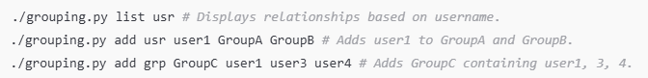
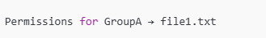

APPROACH TO GROUP-BASED ACCESS CONTROL
Dynamic Role-Based Access Control:
Permissions are assigned at the group level for files.
Groups control access (read, write, execute) dynamically for all associated users.
Core Features
Group and User Management - Grouping.py Easily manage users and groups (create, add, remove).
Examples
File Permissions Management - Auth.py Assign, check, and list permissions for files based on groups.
Example: Assign rwx permissions to GroupA for a file
Run & Test
hook.so intercepts system calls using LD_PRELOAD.
Ensures only authorized users can access files
Run

Slide 5
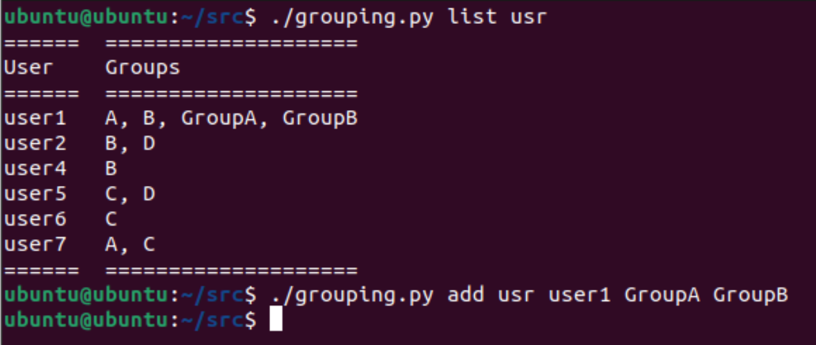
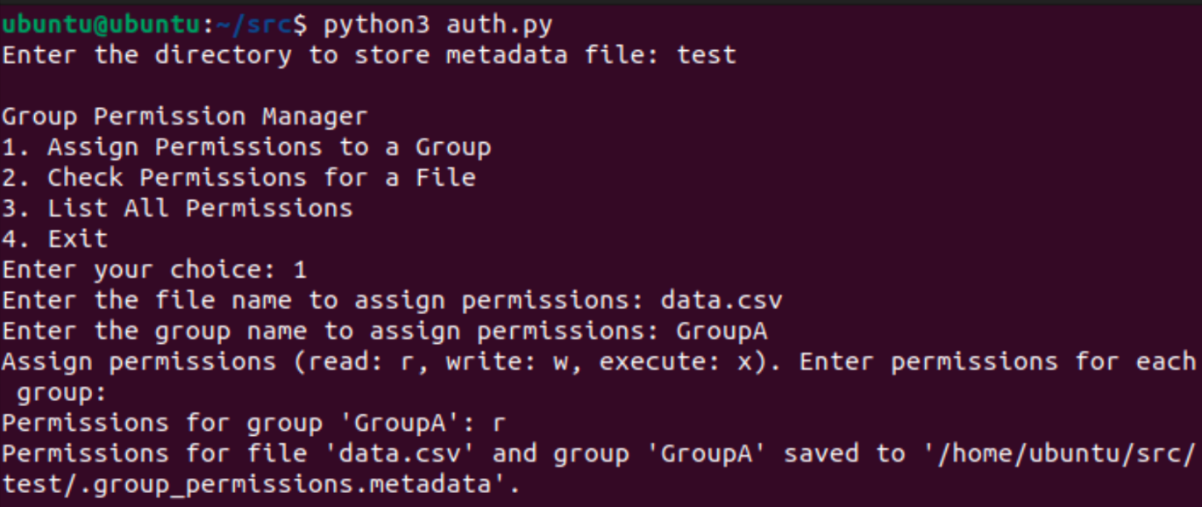
RESULTS & IMPROVEMENTS ACHIEVED
Real-Time Enforcement:
Permissions are dynamically enforced via system call interception (LD_PRELOAD), blocking unauthorized access instantly.
Scalable and Flexible:
Easily add or remove users and groups, simplifying complex access management.
Practical Application:
Professors can share files securely with enrolled students only.
Teaching assistants manage grade files with strict access control.
Students share internal project materials without external leaks.

Slide 6
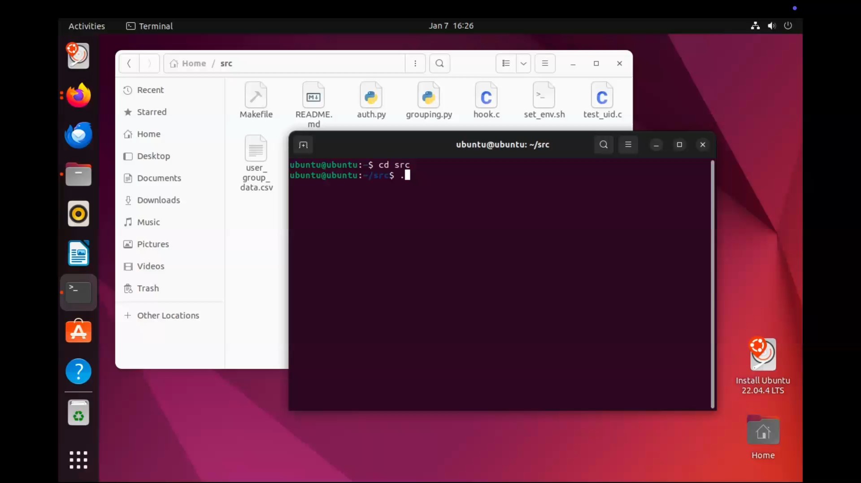
DEMO VIDEO

Slide 7


LIMITATIONS & FURTHER IMPROVEMENTS
Current Limitations:
Implementation - Unable to implement execve hooking due to system instability and time constraints.
No Default Permission Policy - Newly created files lack automatic permission settings, requiring manual configuration.
Partially Dynamic - Does not support dynamic updates to user-group-resource relationships. (Only User - Group Currently)
Further Improvements:
Implement execve hooking to enforce process-level permissions.
Add default permission settings for newly created files.
Enable dynamic management of user-group-resource mappings for flexibility.
Explore cross-platform support to expand usability.

Slide 8


THANK YOU!
https://github.com/Choi-Suhyeon/OperatingSystem_TeamB

